Slide 1
Module:2
Junction Diodes
Intrinsic and extrinsic semiconductors – doping - PN Junctions, Formation of Junction, Physical operation of diode, Barrier Potential, I - V Characteristics, Rectifiers, Zener diode – I-V Characteristics, Zener diode as Voltage regulator.

Slide 2
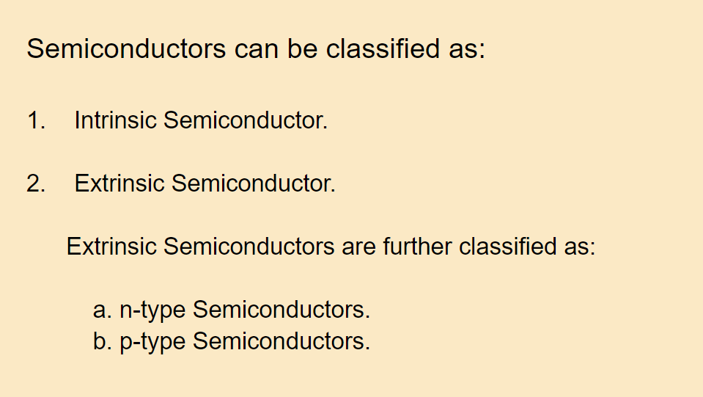
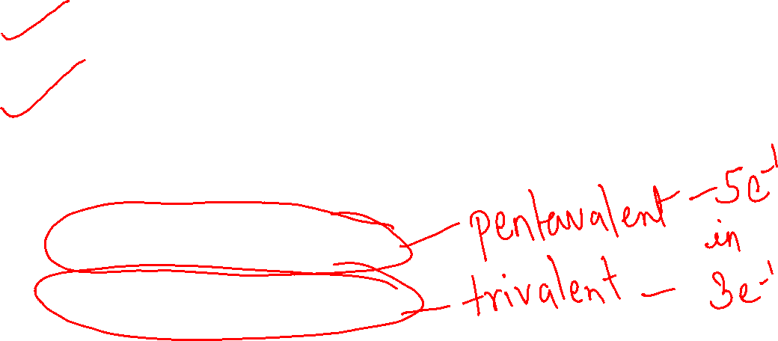

Slide 3
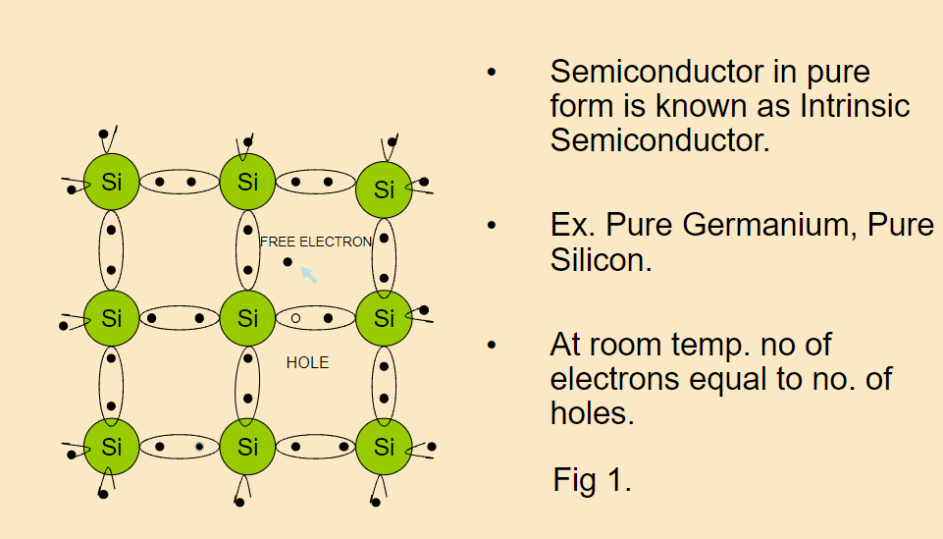
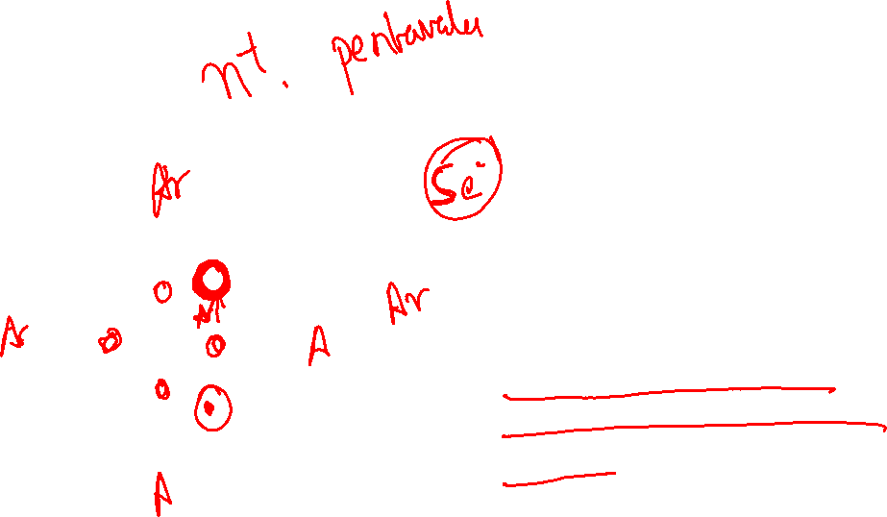

Slide 4
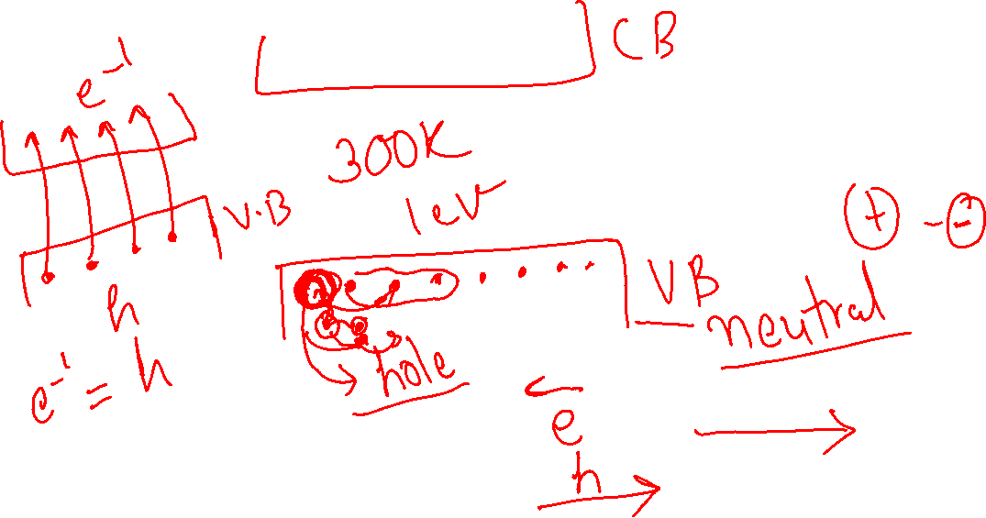

Slide 5
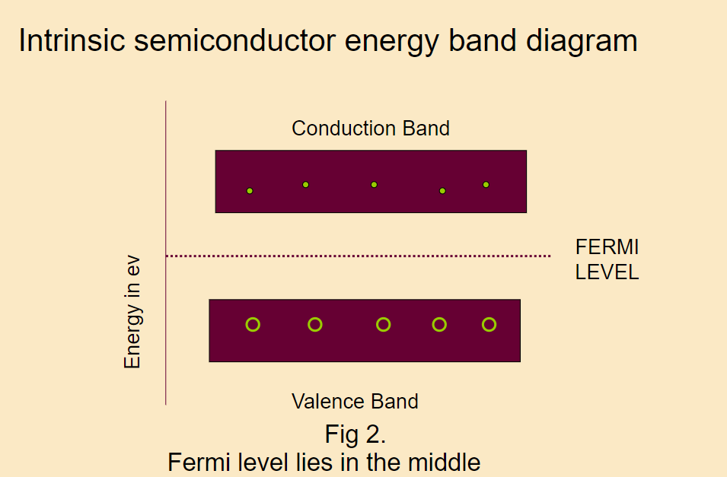
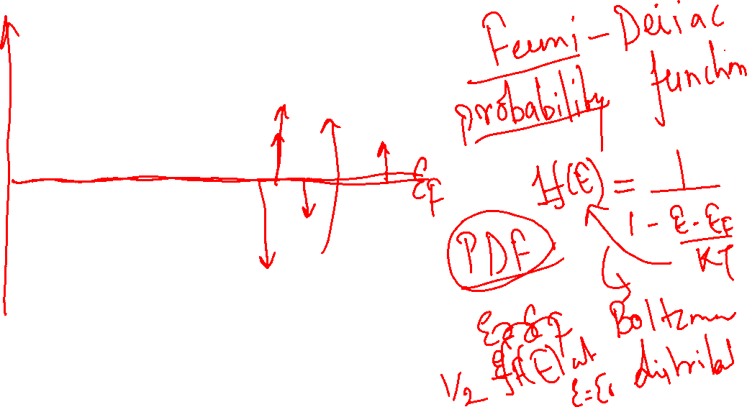

Slide 6
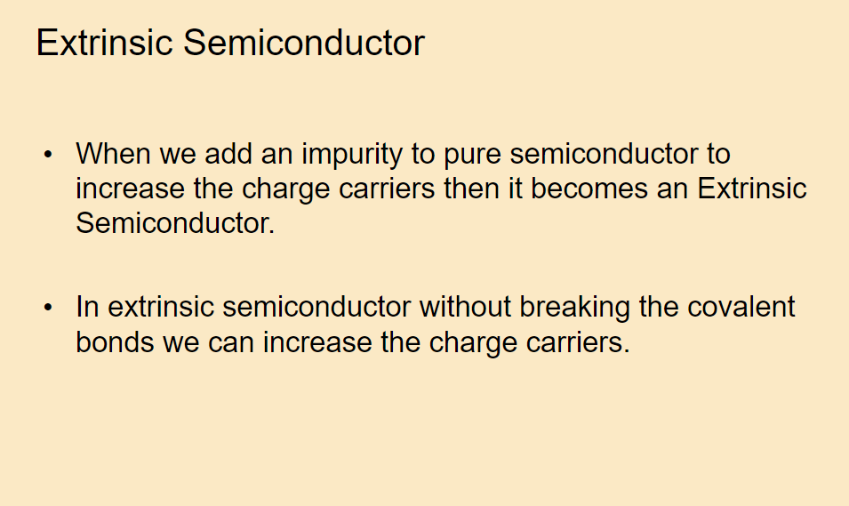
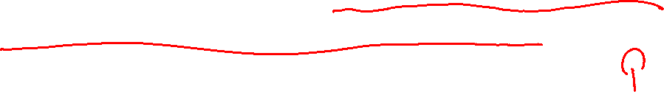

Slide 7
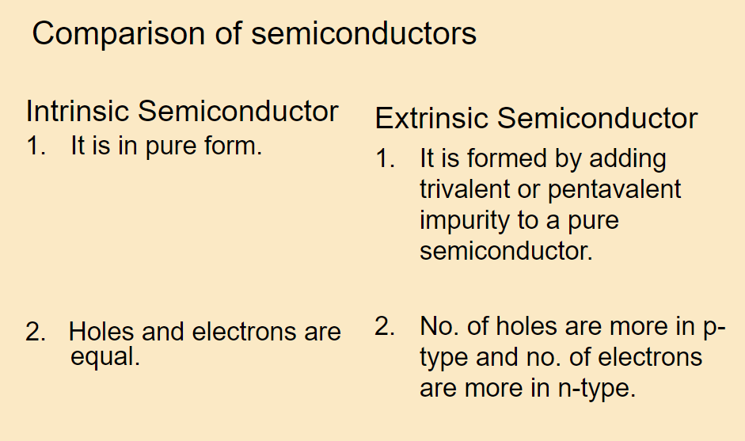

Slide 8
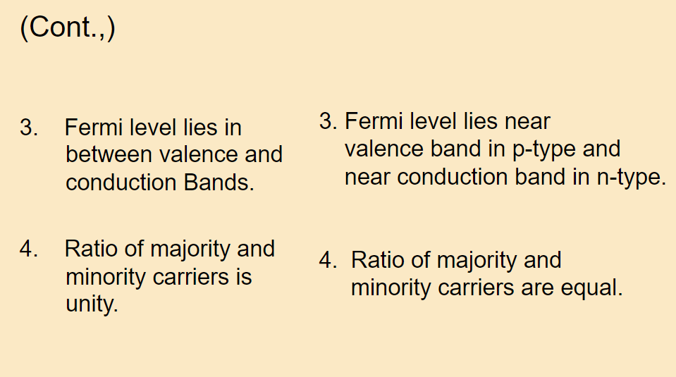

Slide 9
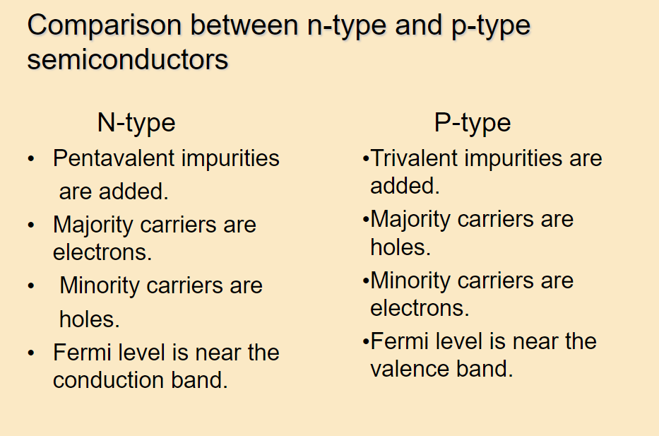

Slide 10
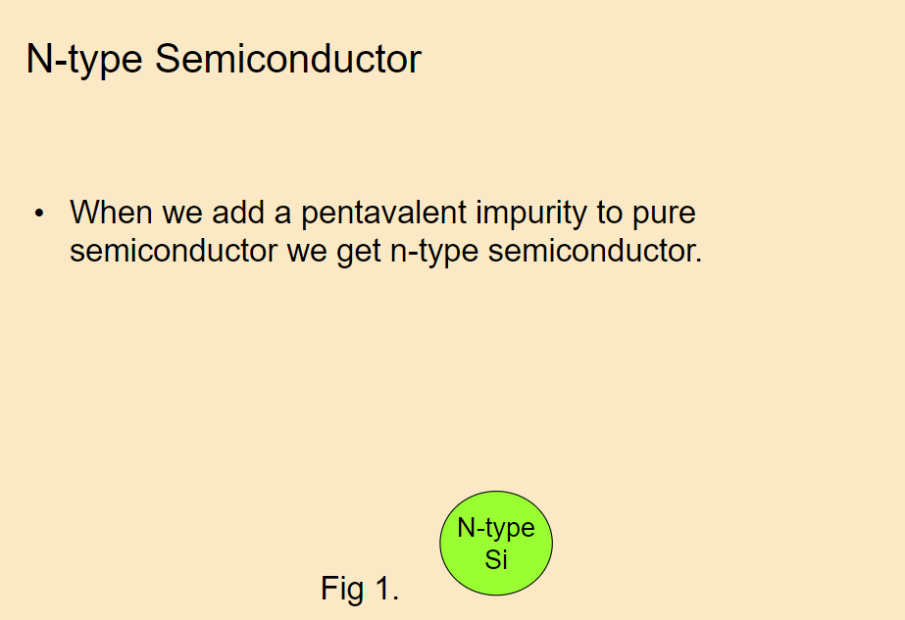
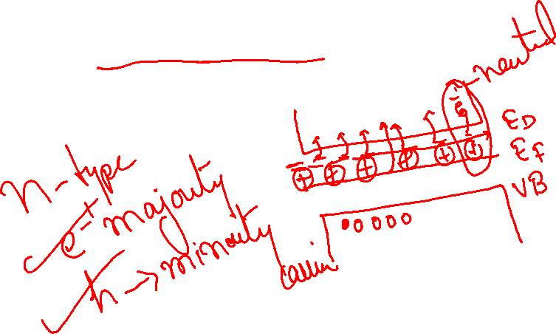

Slide 11
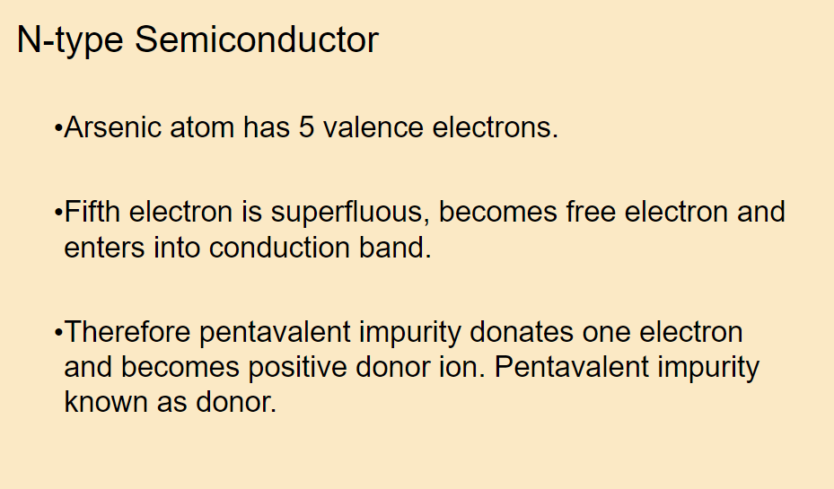

Slide 12
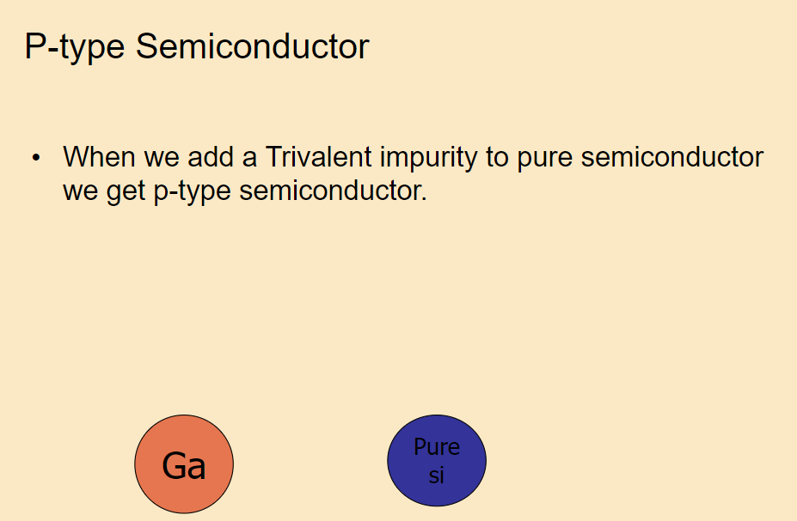
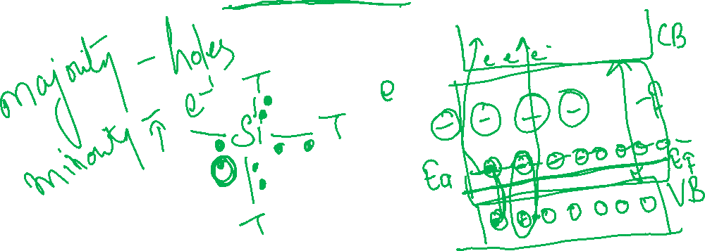

Slide 13
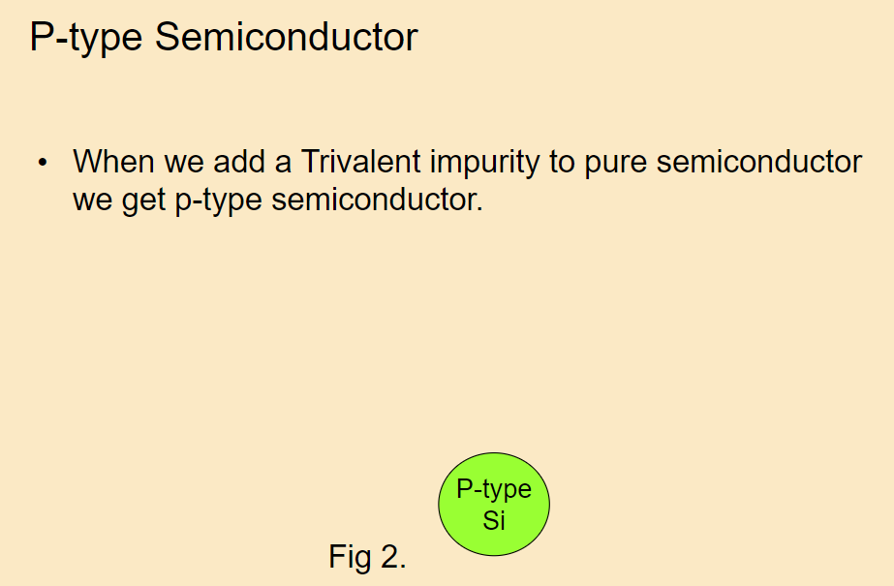

Slide 14
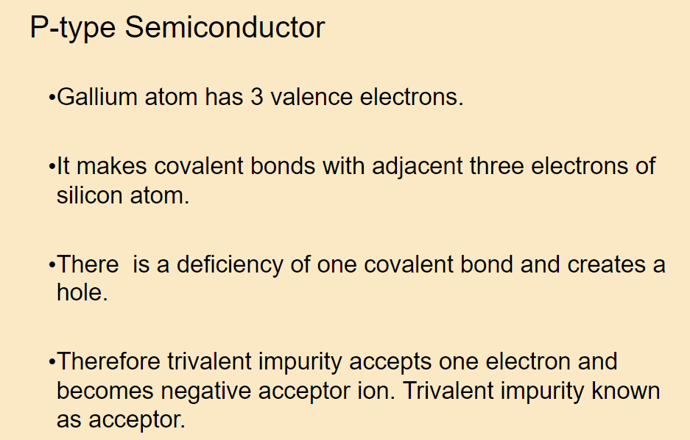

Slide 15
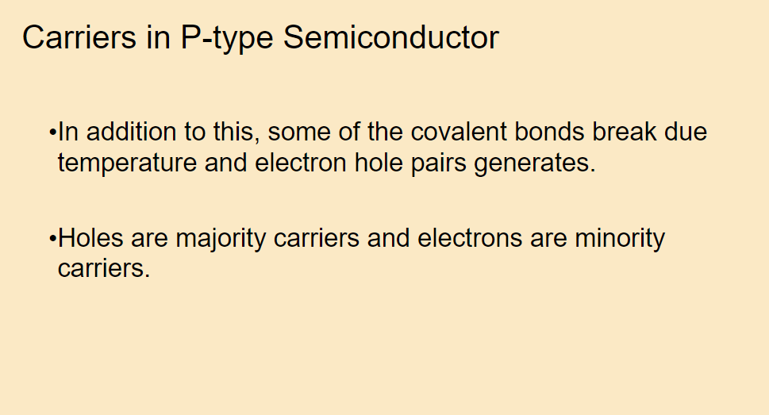

Slide 16
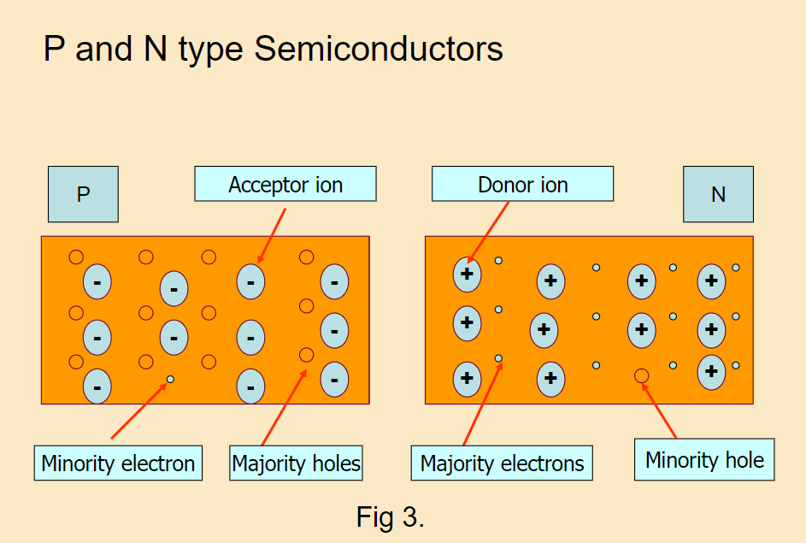


Slide 17
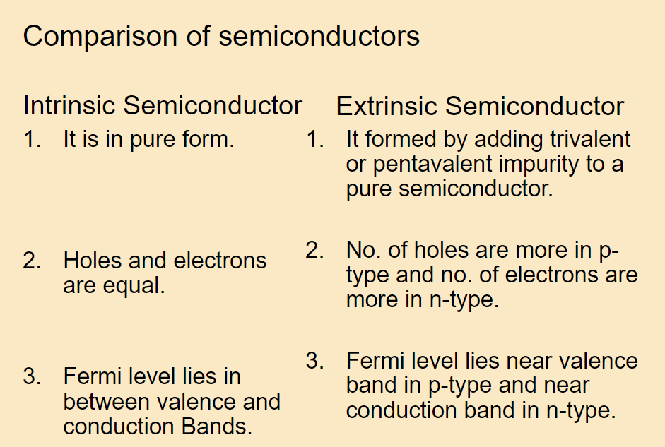
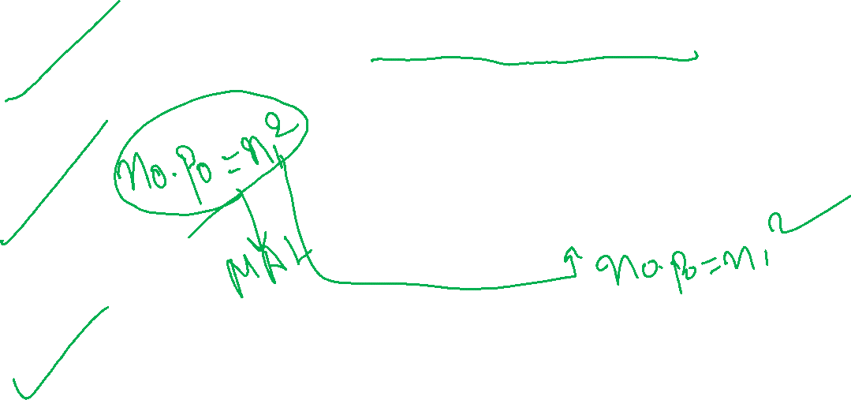

Slide 18
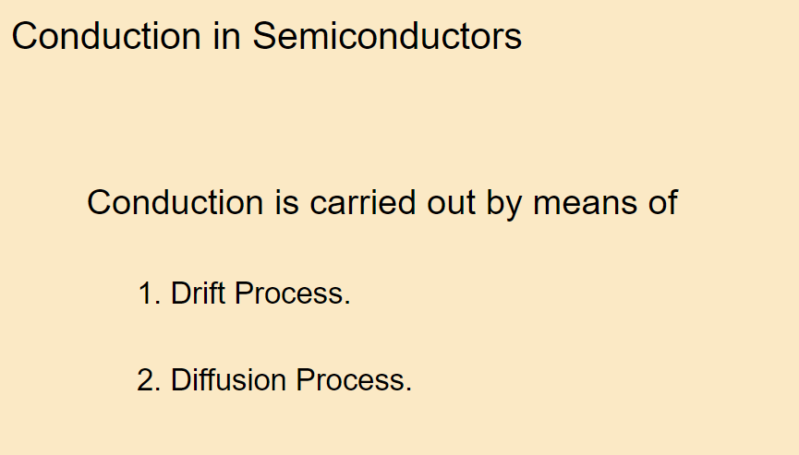
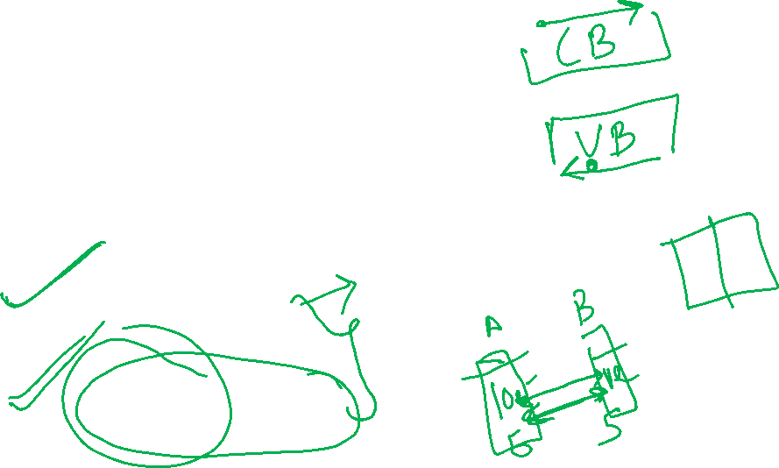

Slide 19
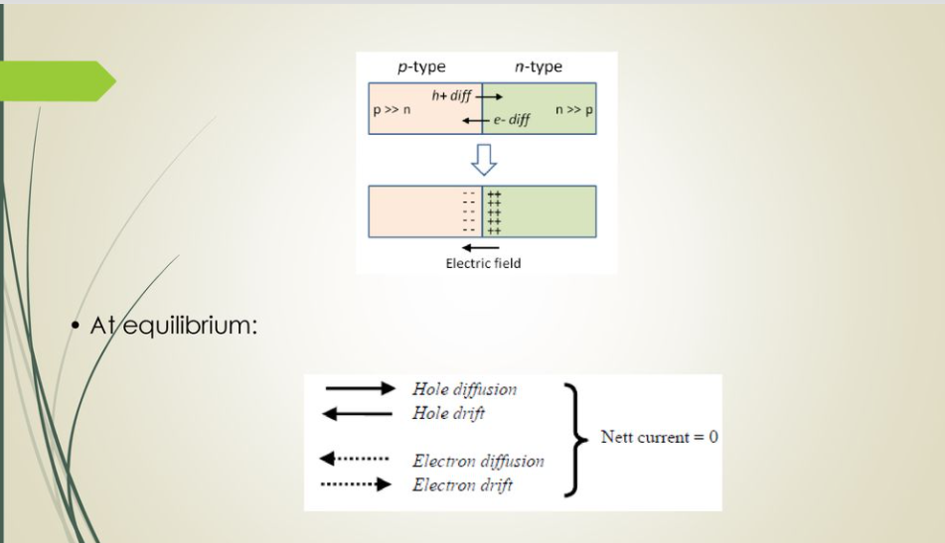

Slide 20
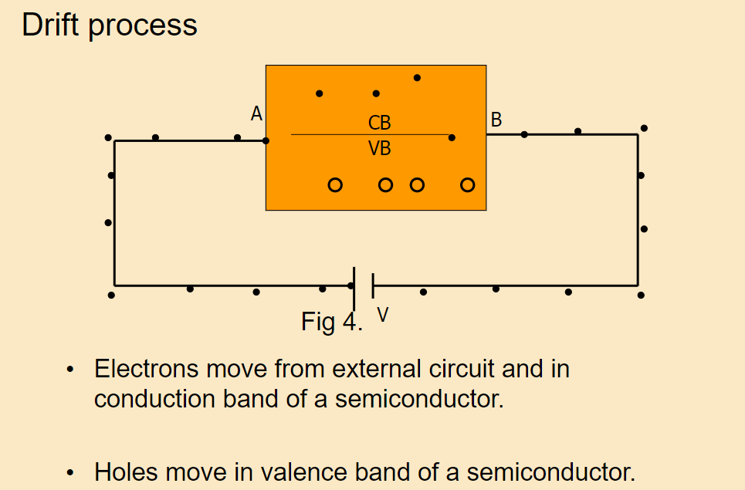


Slide 21
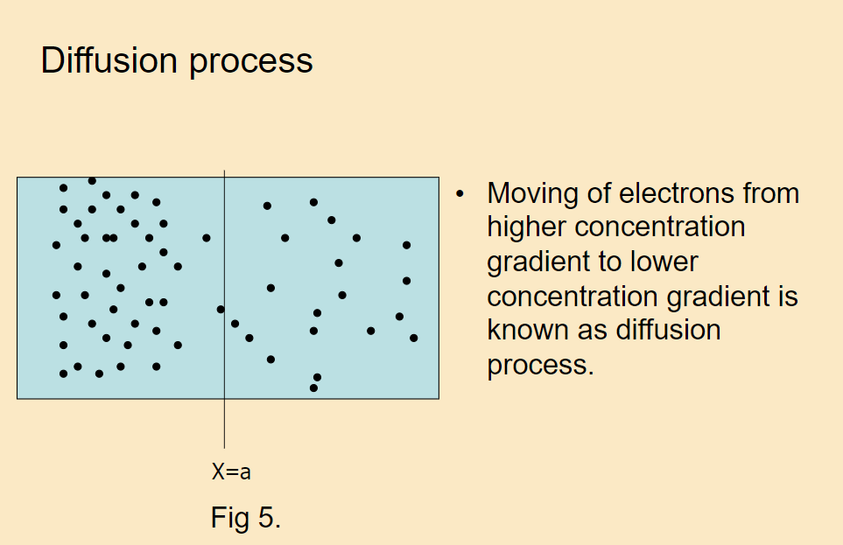

Slide 22
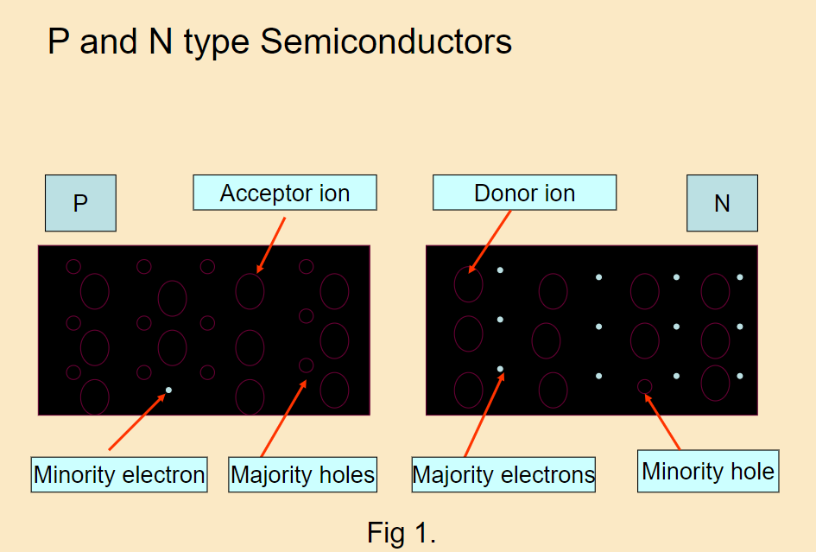
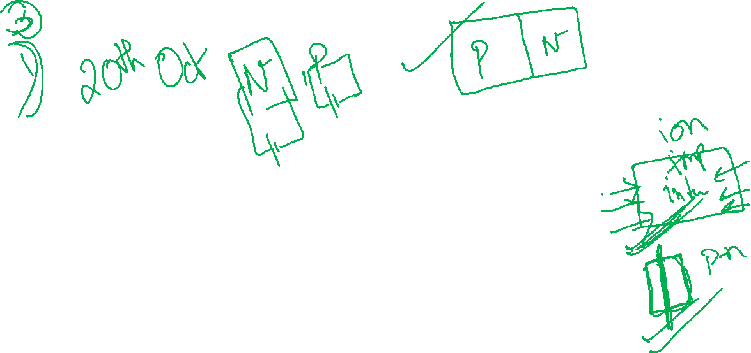

Slide 23
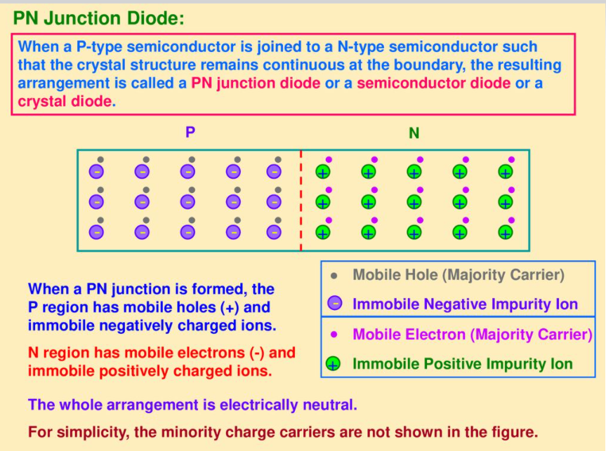
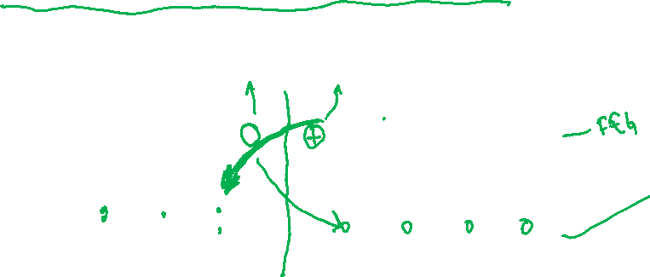

Slide 24
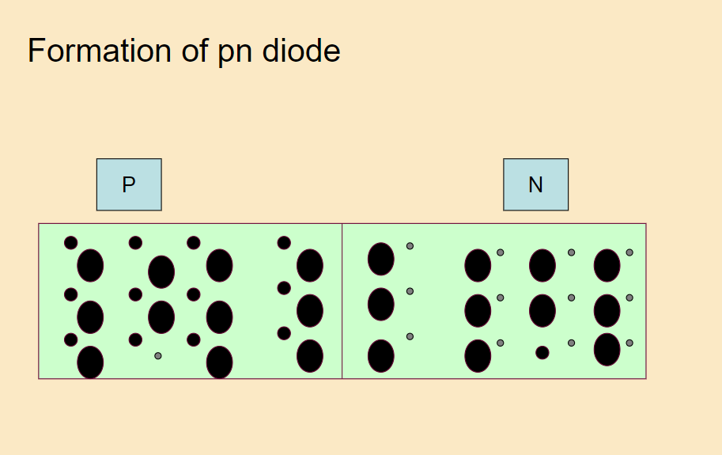

Slide 25
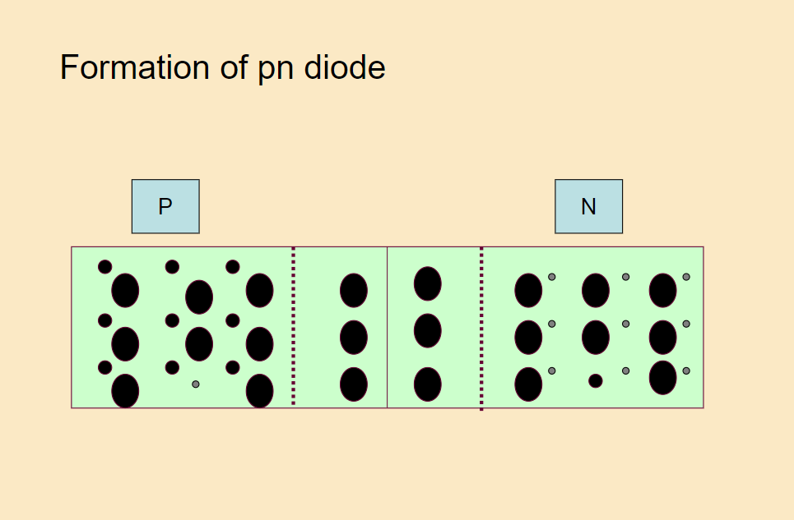
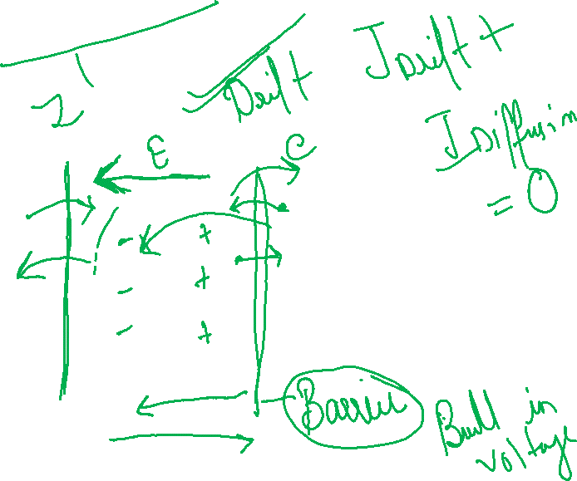

Slide 26
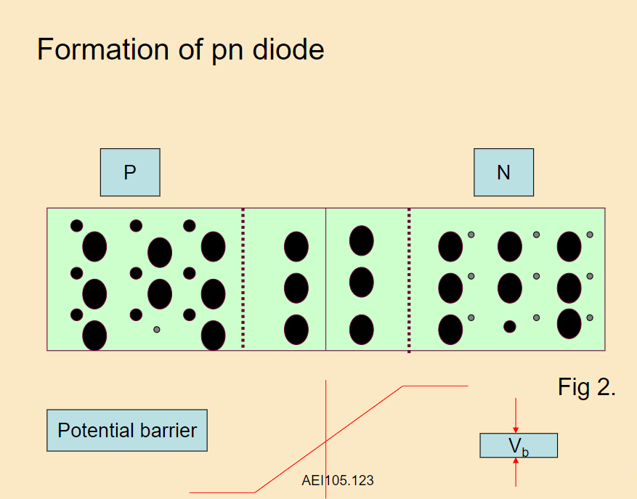

Slide 27
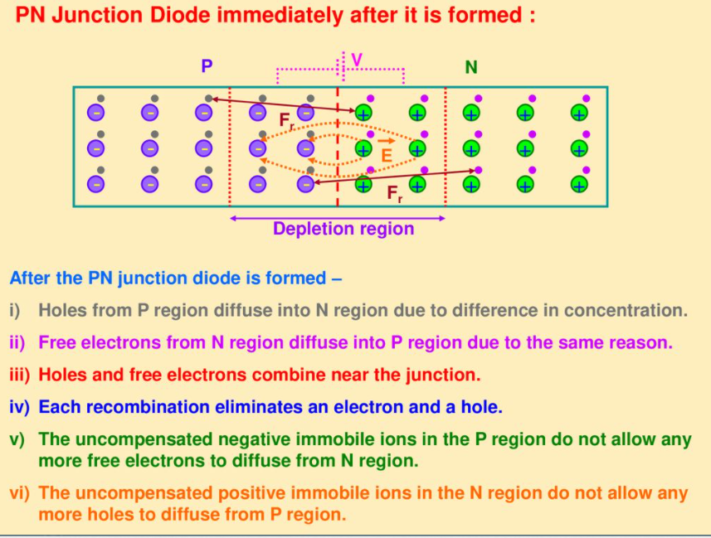
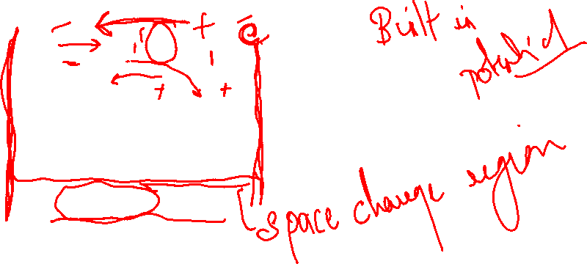

Slide 28
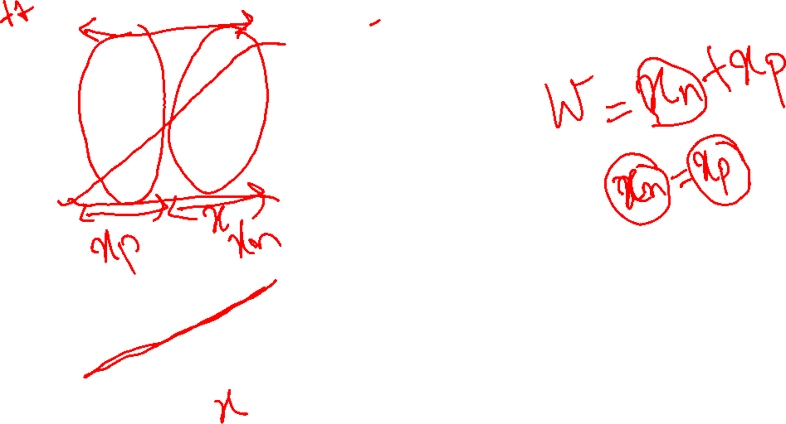
Formation of a PN-junction
Ionized acceptors
Ionized donors
Junction
P
N
-
-
+
+
-
-
+
+
-
-
+
+
-
-
+
+
Space charge region
(DR)
Depletion region
Potential barrier height(V₀)
Potential barrier width
(W)
Gradients drive diffusion: But charges can’t venture too far from the interface because their Coulomb forces pull them back!

Slide 29
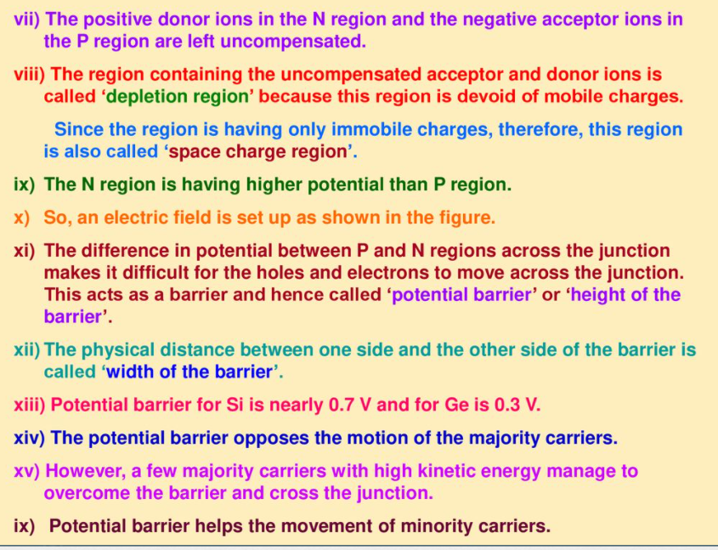

Slide 30
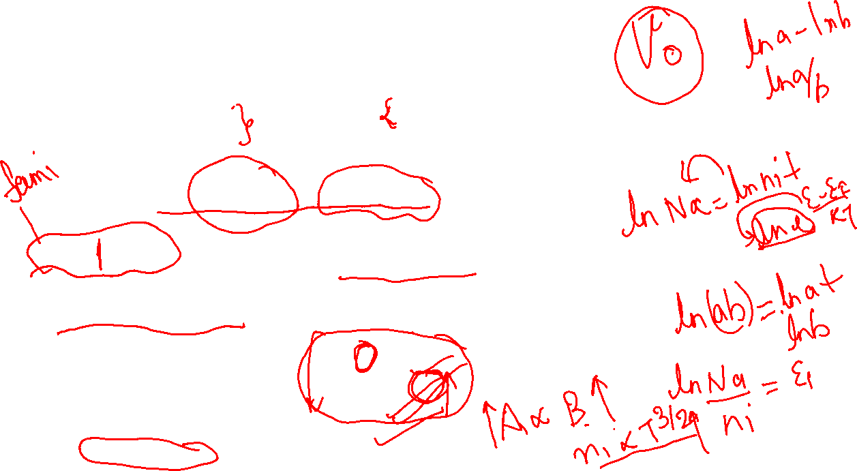
How much is the Built-in Voltage?
P side
N side
N_{a} acceptor level on the p side
N_{d} donor level on the n side
It depends on doping concentration and temperature.
Its TC is negative.

Slide 31

How far does W_{d} extend into each junction?
Depletion width on the n-side depends on the doping on the p-side
Depletion width on the p-side depends on the doping on the n-side
e.g. if N_{A}>>N_{D} then x_{n}>>x_{p} One-sided junction

Slide 32
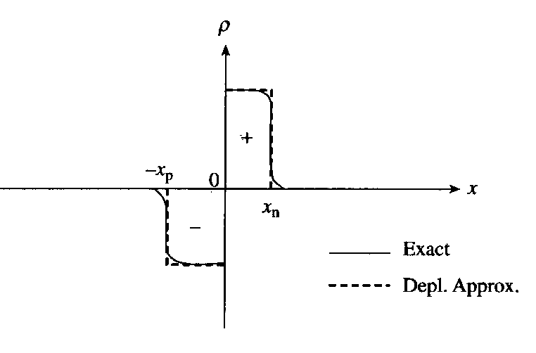
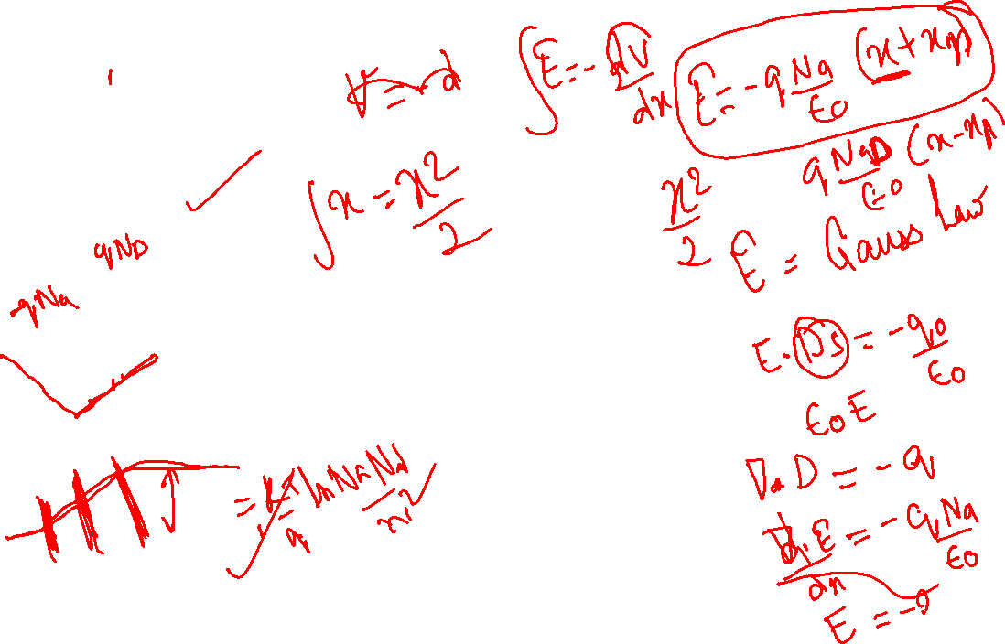
Depletion Approximation, Electric Field and Potential for pn junction
₋ ₋ ₋ ₋
₋ ₋ ₋ ₋
₊ ₊ ₊
₊ ₊ ₊
_{p-type}
_{n-type}
₊ ₊ ₊
₊ ₊ ₊
_{x}
₋ ₋ ₋ ₋
₋ ₋ ₋ ₋
Exponentials replaced with step-functions
At equilibrium, there is no bias, i.e. no applied voltage.
The field takes the same sign as the charge.
The sign of the electric field is opposite to that of the potential ;
Potential Electric field Charge density
_{x}
_{x}
_{Depletion Region}

Slide 33
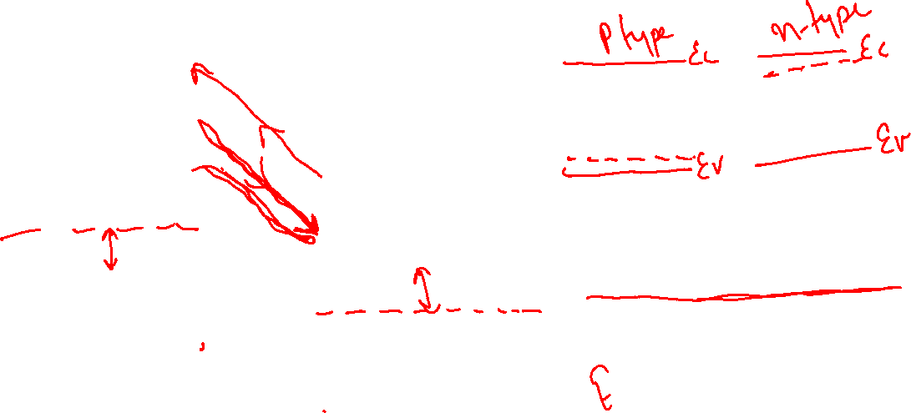
Energy level diagram for the p-n junction in thermal equilibrium
p-type
n-type
_{Electron Drift}
E_{C}
_{Electron Diffusion}
_{Neutral p-region}
E_{C}
E_{f}
E_{f}
E_{V}
_{Hole Diffussion}
_{Neutral n-region}
E_{V}
_{Hole Drift}
Depletion region

Slide 34
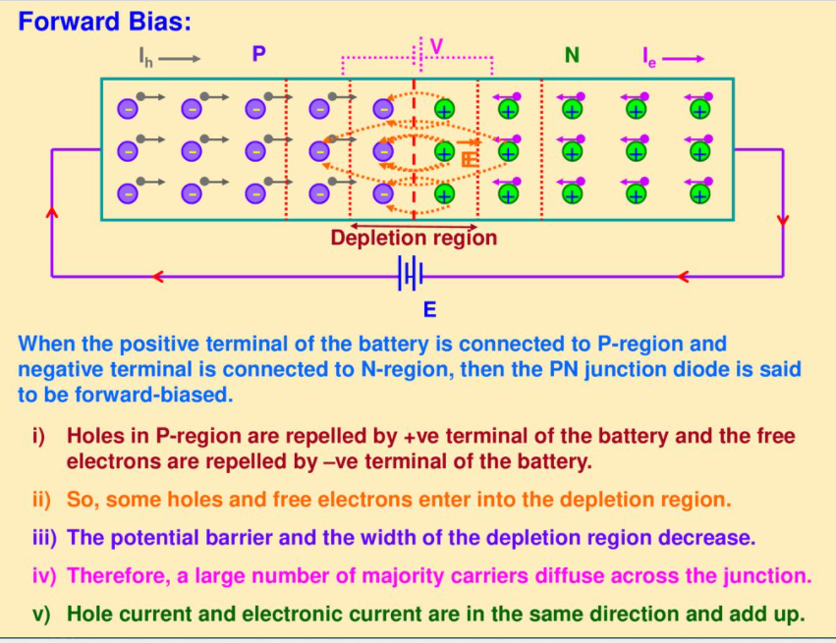
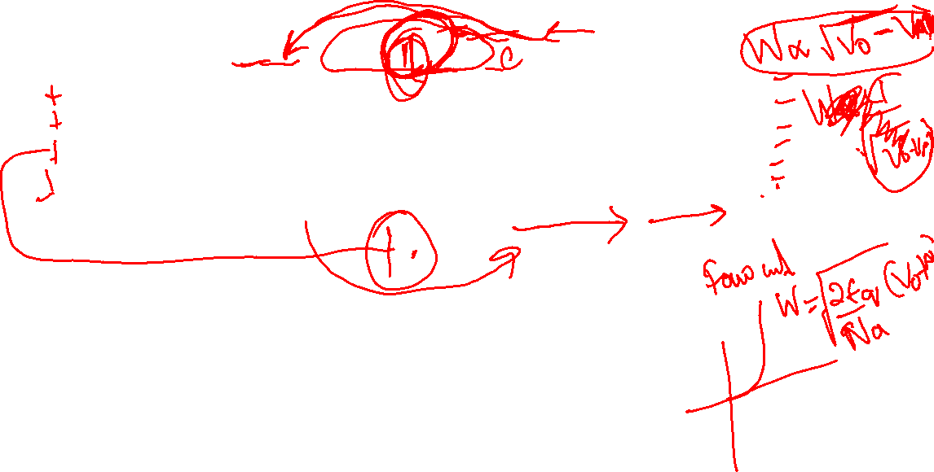

Slide 35
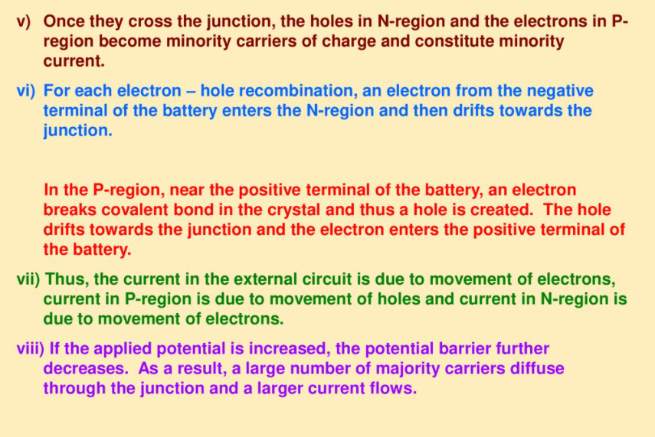
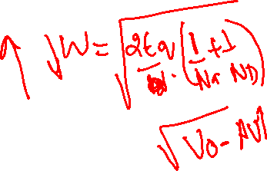

Slide 36
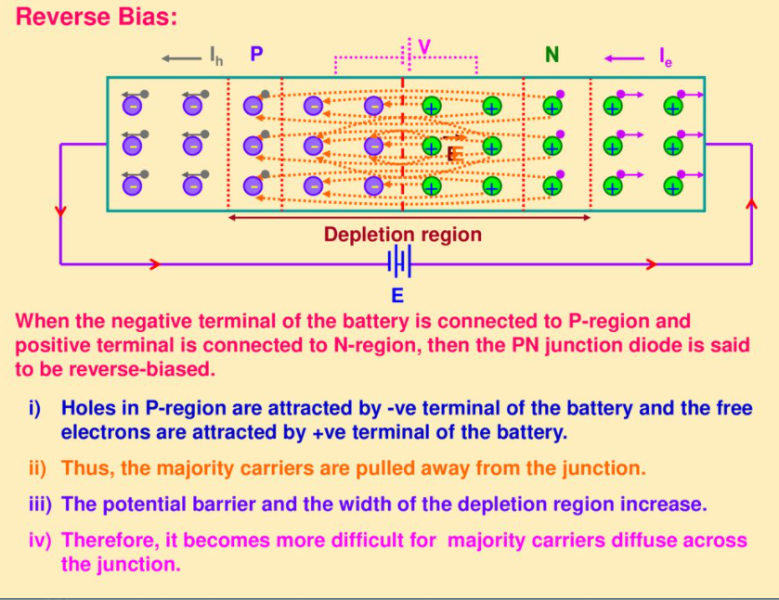


Slide 37
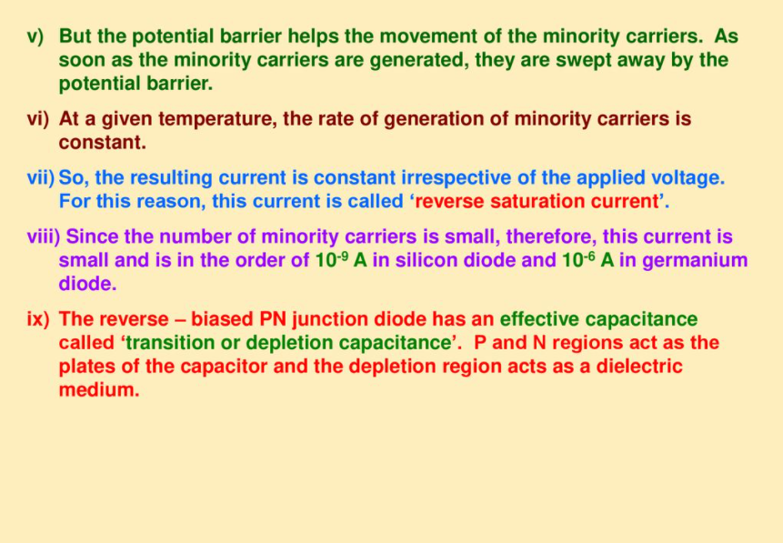

Slide 38


Slide 39


Slide 40


Slide 41


Slide 42


Slide 43


Slide 44


Slide 45


Slide 46


Slide 47



Slide 48



Slide 49



Slide 50


Slide 51


Slide 52


Slide 53



Slide 54


Slide 55


Slide 56


